Slide 1




YOUR VITAL ROLE FOR THE FUTURE OF MINISTRY RECRUITMENT IN THE WELS

Slide 2


WELS
CURRENTLY
HAS A
CALLED
WORKER
SHORTAGE

Slide 3
WELS
CURRENTLY
HAS A HUGE MINISTRY OPPORTUNITY

Slide 4
Then I heard the Lord’s voice, saying, “Whom shall I send? Who will go for us?” Then I said, “Here I am. Send me!”
- Isaiah 6:8

Slide 5
ON AVERAGE, THERE ARE
4,870 CONFIRMED WELS (& ELS) MEMBERS ATTENDED WELS HIGH SCHOOLS PER YEAR.

Slide 6



























WELS HS STUDENT BREAKDOWN
4,870
27%
13,000
73%

Slide 7

MLC UNDERGRADUATE BREAKDOWN
50% + 33% = 83%
17%

Slide 8

CAN WE CONTINUE ON THE SAME PATH OF RELYING ON THE WELS HIGH SCHOOLS FOR MINISTRY CANDIDATES?

Slide 9
THE 2025
ENROLLMENT CLIFF
(THANKS 2007 RECESSION!)

Slide 10
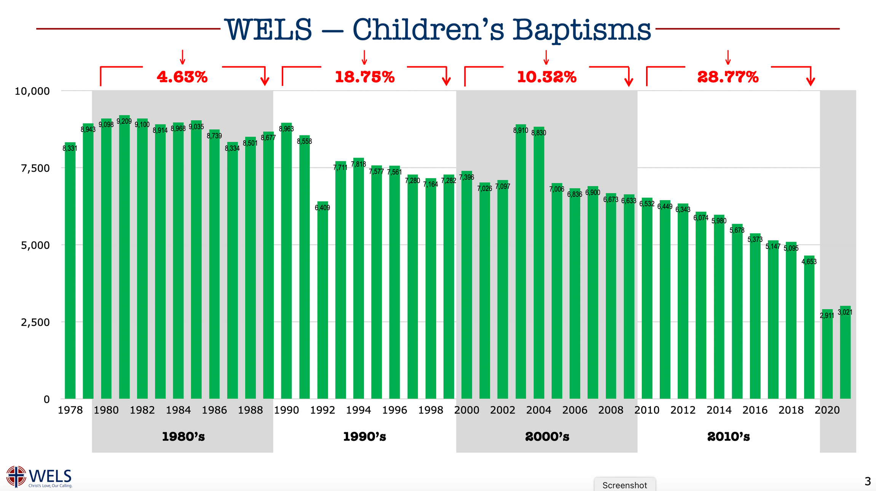



Slide 11
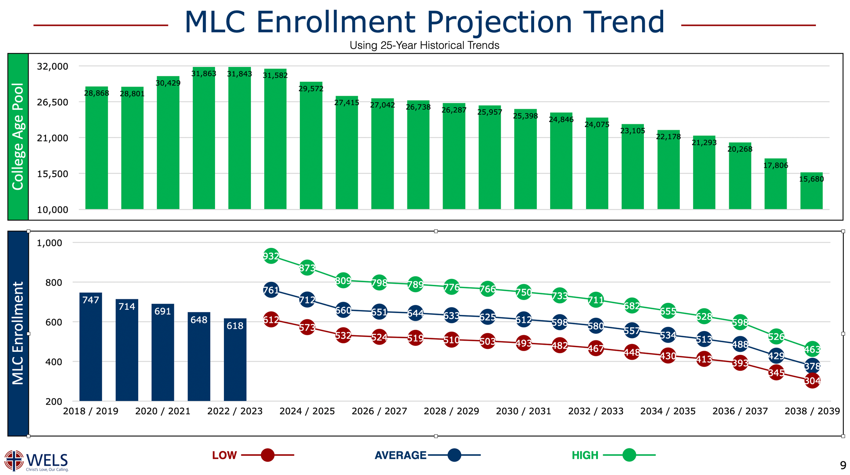


Slide 12

CANDIDATES FOR CALL DAY
2034
PASTORS
2034

Slide 13



CANDIDATES FOR CALL DAY
2034
PASTORS
2034
7th-8th Grades
Juniors

Slide 14


Slide 15

“SO CHRIST HIMSELF GAVE THE APOSTLES, THE PROPHETS, THE EVANGELISTS, THE PASTORS AND TEACHERS, TO EQUIP HIS PEOPLE FOR WORKS OF SERVICE, SO THAT THE BODY OF CHRIST MAY BE BUILT UP UNTIL WE ALL REACH UNITY IN THE FAITH AND IN THE KNOWLEDGE OF THE SON OF GOD AND BECOME MATURE, ATTAINING TO THE WHOLE MEASURE OF THE FULLNESS OF CHRIST.”
- EPHESIANS 4:11-13

Slide 16
“WE NEED TO TARGET THE INFLUENCERS OF THE YOUNG PEOPLE AND NOT THE YOUNG PEOPLE THEMSELVES. THE SCHOOLS AND THEIR RECRUITERS CAN BE WONDERFUL AND APPROPRIATE RESOURCES FOR THE INFLUENCERS BUT THE INFLUENCERS HAVE TO CARRY THE MAIL AND DO THE LION'S SHARE OF THE WORK. WE NEED TO HELP PROSPECTIVE INFLUENCERS TO SEE THEMSELVES AS INFLUENCERS AND TO WANT TO ACTUALLY INFLUENCE THE YOUNG PEOPLE TO CONSIDER MINISTRY.”
-QUOTE FROM A WELS DISTRICT PRESIDENT

Slide 17


NON-TRADITIONAL EDUCATION PROGRAM
(CBE)
FOUR-TIER EARLY CHILDHOOD PROGRAM
MINISTRY CERTIFICATION
SEMINARY CERTIFICATION
POST-BACCALAURATE
STAFF MINISTRY
EARLY CHILDHOOD
ELEMENTARY EDUCATION
PRE-SEMINARY
MIDDLE/SECONDARY EDUCATION

Slide 18


Slide 19



CALLED WORKERS...
LOVE THE WORK THE LORD HAS GIVEN YOU!

Slide 20

CALLED WORKERS...
BE CAREFUL HOW YOU SPEAK ABOUT CHALLENGES OF THE MINISTRY.

Slide 21

BE CAREFUL ABOUT THE SUBTLE DISCOURAGEMENTS THAT WE CAN GIVE TOWARDS THE GOSPEL MINISTRY.

Slide 22

MAKE SUBTLE ELEVATION EXPERIENCES WITHIN YOUR CONGREGATION AND MINISTRIES.

Slide 23


HOW OFTEN TO DO YOU GLOW ABOUT THE THINGS THAT YOU GET TO DO DAILY IN THE PUBLIC MINISTRY?
HOW OFTEN DO YOU ELEVATE THE WAY THAT YOU TALK ABOUT THE CALLED WORKERS THAT INFLUENCED AND CURRENTLY INFLUENCE YOUR LIFE?

Slide 24

MINISTRY-BOUND COLLEGE STUDENTS HAVE POINTED TO THE IMPORTANCE OF...

Slide 25
A PASSIVE EXAMPLE:
CALLED WORKER’S PASSION, SKILL, ACTION, AND, IN MOST CASES, LITERALLY AN ‘EXAMPLE.’
AN ACTIVE ENCOURAGER:
SOMEONE WHO SHARES WORDS AND ENCOURAGEMENTS WITH OTHERS ON THEIR POTENTIAL FOR GOSPEL MINISTRY.

Slide 26


“I FIRMLY BELIEVE THAT RELATIONSHIPS ARE THE SWEET SPOT TO RECRUITMENT. THAT COULD BE WITH ANY NUMBER OF PEOPLE. A MENTOR, A COACH, A PASTOR, A FRIEND.”
-PASTOR DUSTIN SIEVERT

Slide 27

THERE ARE THOUSANDS OF WELS TEENS THAT MLC DOESN’T KNOW EXISTS. YOU KNOW THEM!
CAN MLC TOO?

Slide 28

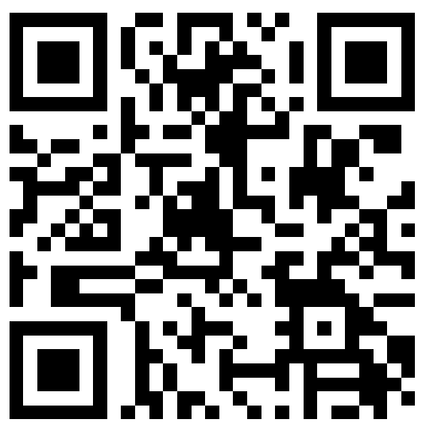

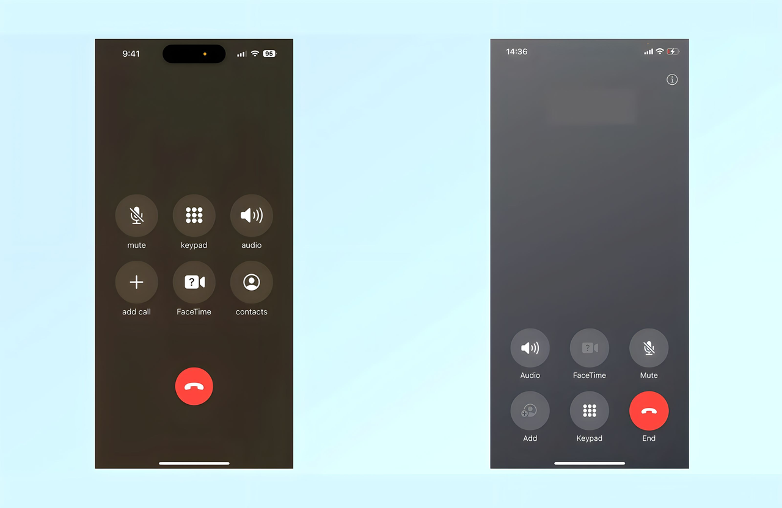
SHARE THE NAMES OF
YOUR YOUTH WHO
DEMONSTRATE GIFTS
FOR MINISTRY WITH MLC
RESPOND TO MLC’S
REQUEST FOR YOUR
CONFIRMAND’S
CONTACT INFO
DIRECTLY CONTACT
MLC ADMISSIONS IF
THERE IS SOMEONE
THAT WE CAN TALK WITH
MLC
507-354-8221

Slide 29



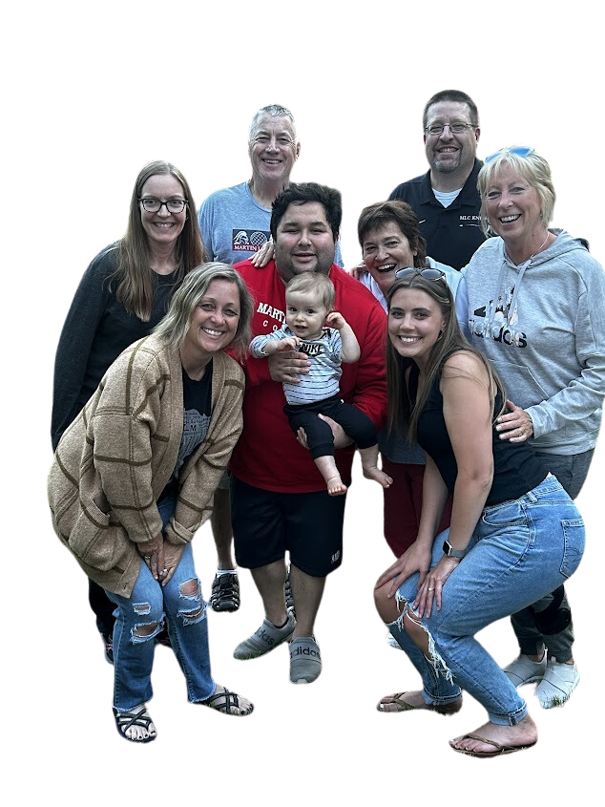





ENCOURAGING SNAIL MAIL AND EMAIL DIRECTLY TO THE CANDIDATE
DISCUSS OPTIONS VIA A VIRTUAL MEETING WITH MLC ADMISSIONS
MANY PRAYERS CONCERNING
THE CANDIDATE
CONSIDER A
CAMPUS VISIT TO MLC

Slide 30
WHAT ARE SOME SPECIFIC WAYS THAT YOU CAN INCREASE THE LEVEL OF ENCOURAGEMENT FOR THE PUBLIC MINISTRY?
WHO DO I NEED TO CONNECT WITH TO ENSURE THAT WE DO SOMETHING TO INCREASE ENCOURAGEMENT?

Slide 31
We leave it to the Lord and praise Him for every young person who pursues the holy ministry despite the “great and heavy cares and worries connected with it.” To remove them all would be to lie. Instead, we remember that Jesus instructed his disciples to “ask the Lord of the harvest” (Matt 9:38). May we continue to do so, whether in personal prayer or as congregations across the WELS pray, “help [our children] distinguish between what is passing and what is eternal, between instant thrills and lasting joy.” Then, let God use us as an answer. Let us live out this noble task displaying the light of that “lasting joy” so that this ripe harvest of candidates “may see your good deeds and glorify your Father in heaven” (Matt 5:16).
-QUOTE FROM SEMINARIAN RYAN GURGEL

